Slide 1
APIs and API Management
William A Brown
CTO Cloud Application Services WW Cloud CoC
brownaw@us.ibm.com
Notes:
This is module will cover XYZ. Let’s get started.

Slide 2
diminishing returns
NOT SAYING that
Legacy systems lack business value or have diminishing value OR
Existing applications are not being maintained or even invested in
SAYING that
These systems, as structured, are no longer producing significant value to (1) drive new revenue, (2) retain customers, (3) acquire new customers or (4) improve brand
Diminishing Return
Many major application categories are in diminishing returns
ERP
SCM
Batch
Commerce
Value
Cumulative Investment in Applications

Slide 3
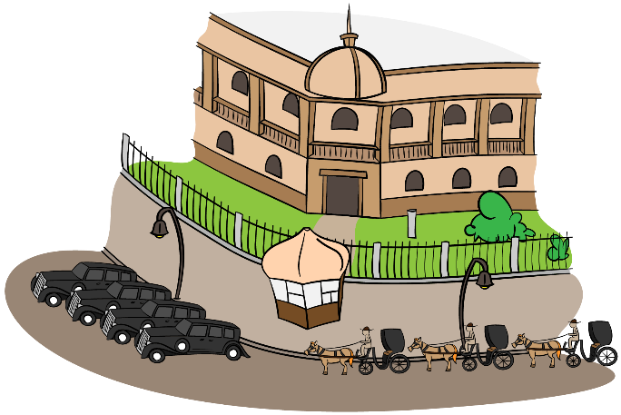
Bi-modal and Two (N?) Speed Architecture
Bimodal IT, a combination of old-style and modern IT practices is a prescriptive organization model for IT organizations which has two separate flavors:
Type 1 is traditional IT, focused on stability and efficiency,
Type 2 is an experimental, agile organization focused on time-to-market, rapid application evolution, and, in particular, tight alignment with business units.
Two speed architecture, implies a fast-speed, customer centric front end (e.g., system of engagement) running alongside a slow-speed, transaction focused legacy back end (e.g., system of record).
In bimodal IT the CEOs or CIOs might be so tired of how poorly their IT organizations are performing that they’re setting up separate organizations to pursue new opportunities is consistent with pursuing bimodal IT.
Two speed - Fast speed means instant cross channel deployment of functionality, maybe using microservices, zero downtime, and possibly many software releases daily.
Two speeds means digital initiatives can be implemented by IT using a second speed, one muct faster than the normal pace of IT delivery. A two-speed IT architecture will help companies develop their customer-facing capabilities at high speed while decoupling legacy systems for which release cycles of new functionality stay at a slower pace
The interface needs thought! Expect gears to grind.

Slide 4

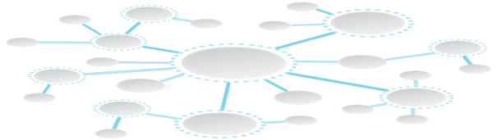


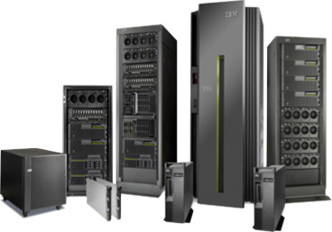
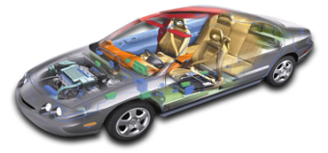

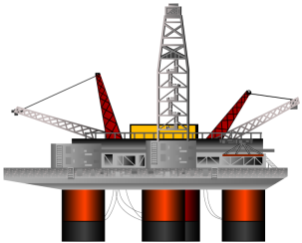

New modes of engagement
Systems of Record
Systems of Engagement
Data & Transactions
App Infrastructure
Virtualized Resources
Expanding Interface Modalities
Big Data and Analytics
Social Networking
Next
Generation Architectures
Data & Transaction Integrity
Smarter Devices & Assets

Slide 5

A platform is a system that can be …
“A platform is a system that can be adapted to countless needs and niches that the platform’s original developers could not possibly have contemplated…”
Mark Andreeson: Venture Capitalist, Netscape Founder, Board HP, eBay

Slide 6
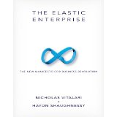
Can platforms shield companies from poor economic climates?
Internet and Cloud era companies grow in both good and poor economic climates because of their business driven platforms and supporting ecosystem
Nicholas Vitalari and Haydn Shaughnessy in, The Elastic Enterprise: The New Manifesto for Business Revolution

Slide 7

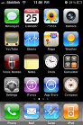




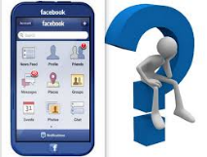

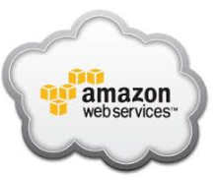


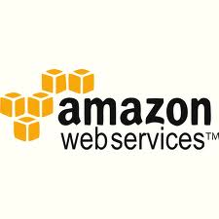

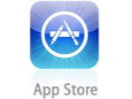
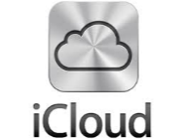
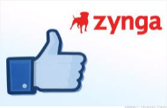



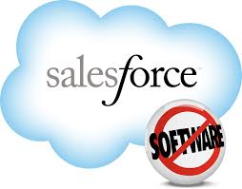

Successful Platforms
“Industry platforms are products, services or technologies that are developed by one or several firms, and which serve as foundations upon which other firms can build complementary products, services or technologies.”
Gawer, taken from Parker & Van Alstyne
http://platformeconomics.org/platform-markets/

Slide 8
Characteristics of Platforms
Engaging customer experience
Proprietary storefront and often a marketplace
Platform SDK for developers along with developer portal
Promotes ecosystem of partners and developers using partner & public APIs
Recognizes that traditional channels cannot reach long tail – encourage co-innovation
Privately labeled seamlessly integrated frontend for any device or Internet thing
Platforms accumulate data for insight, strategic control and customer value
Platform is a strategic control point and source of innovation
Platforms use cloud, mobility, analytics, social platforms and security at their core, a must do and have
Platforms are not implicit, its an overt act, companies have platform strategies

Slide 9
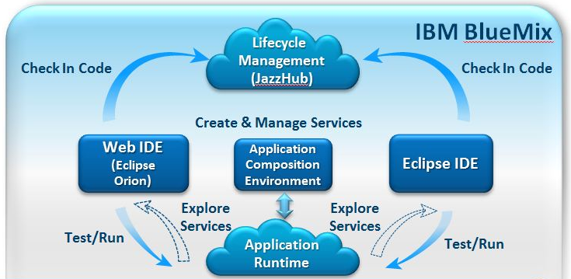
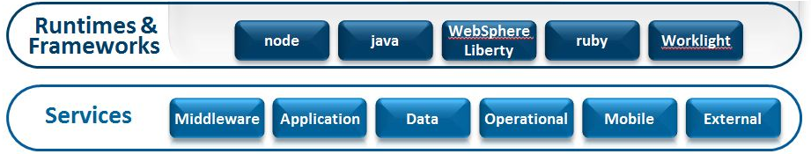
Bluemix PaaS and an Accelerator
Bluemix is IBM’s new PaaS solution that combines the power of Cloud Foundry + popular languages and IBM software as a service
For developing and deploying Omni-channel applications, such as mobile and web applications.
Delivers a set of pre-built services ready for immediate use and hosting infrastructure to host application and business logic for mobile and web developers.
Built on the Cloud Foundry open source technology and offers more control to developers
Runs on IBM SoftLayer* Infrastructure. SoftLayer, an IBM Company, provides cloud infrastructure as a service from 13 data centers in the United States, Asia, and Europe.
To read more about SoftLayer, refer to https://w3-connections.ibm.com/wikis/home?lang=en-us#!/wiki/Wb39726536f17_4b0c_85ea_df1aadd645c1/page/SoftLayer%20Cloud%20Virtual%20Summit%20for%20Architects

Slide 10


Healthy API Economy?
Yeah, I got APIs
I know a guy who knows a guy who knows of an API … but don’t tell anyone

Slide 11
APIs just a new name for SOA? – Nah I don’t think so
There are many similarities – but one very important difference:
The objective most have been focusing on achieving with them
“How can I increase the pace of innovation?”
“How can I increase the agility and effectiveness of delivery?”
APIs
SOA
Reuse → Speed to deliver
Sharing → Expediency
Encapsulate → Less to learn
Reuse → Effort to deliver
Sharing → Effectiveness
Encapsulate → Less to change

Slide 12

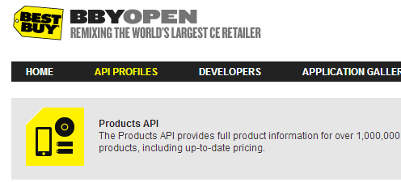


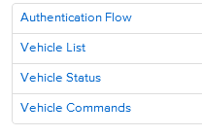
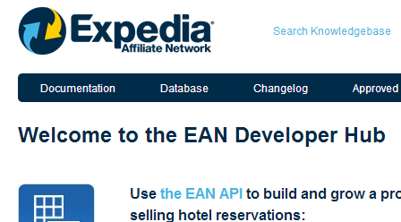


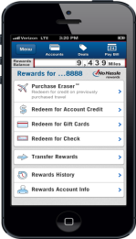
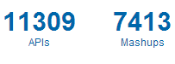
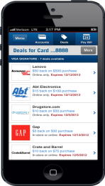


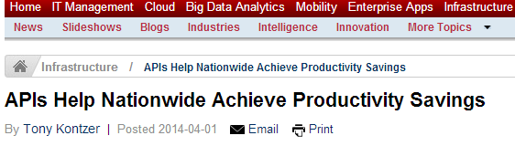

Business APIs provide real value across industries
REST APIs
for Mobile Apps
Public APIs

Slide 13








API Business Models
For Free
Developer Pays
Developer Gets Paid
Indirect
Drives Adoptions of APIs
Typically low valued assets
Drive brand loyalty
Enter new channels
Business Asset must be of high value to the Developer
For example, marketing analytics, news,
Capabilities such as credit checks
Provides incentive for developer to leverage web API
Ad placements
Percentage of revenue sold product or services
Use of API achieves some goal that drives business model.
E.g. Increase awareness of specific content, or offerings
Example:
Example:
Example:
Example:
Facebook Login API provides free authentication for any Web / mobile app
Alchemy ML APIs, provide various ML algorithms as a service
Google AdSense APIs pay developers who include advertising content into apps
eBay Trading APIs offer developers access to trading services extending the reach of listings and transactions

Slide 14





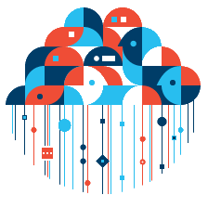



APIs are the foundation of a Composable Business
API
API
Big Data
Assets
Social
Users
Big data sources provide insights that are shared and monetized through APIs
Attributes of a Composable Business
Social APIs fuel personalized experiences for users and new business models
Omni-channel
Operates with agility
Re-invents itself
Cloud
Web Apps
Mobile
Apps
Cloud services are exposed through Web APIs enabling rapid composition environments
API
API
Mobile applications make calls to back end services through Web APIs

Slide 15
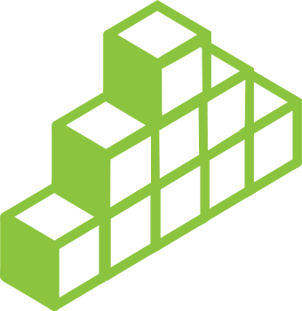







API Economy Reference Model
Channels: Smartphones • Tablets • Desktops • Cars • TVs • Others
Capabilities for API Consumers
Composition
App Management
and DevOps
Consume
Industry Accelerators
Mobile Accelerators
Marketplaces
Social Feedback and Communities
Business Support Systems
Internal Developers
Partner Developers
External Developers
Promote
Self-Service Portal: Registration • Documentation • Sandbox
Capabilities for API Providers
Security and Platform Man.
Analytics and Metering
Produce
API & Service Design & Integ.
API & Service DevOps
Services: Data • Processes • Applications • Cloud & 3rd party integration
Cloud / On-prem / Hybrid Hosting

Slide 16
Trends:
How APIs are transforming Banking services today
Expanding
Model | Goal
Self-service API portal for internal development | Support Omni-channel strategy and 360 view of customer. API model for loosely coupling internal channel development. Internal exposure of business logic as APIs
APIs for Apps ecosystem | Offering APIs to create an Apps ecosystem and foster innovation. Offers marketing & branding visibility
B2B | APIs for Customer-Bank integration (i.e. accounting packages receiving banking statements or payments)
API for open data access | Open access to data in public or private organization
API Standardization | API standardization to foster reusable app development
Banking API Platform | API platform to access banking data
Emerging

Slide 17
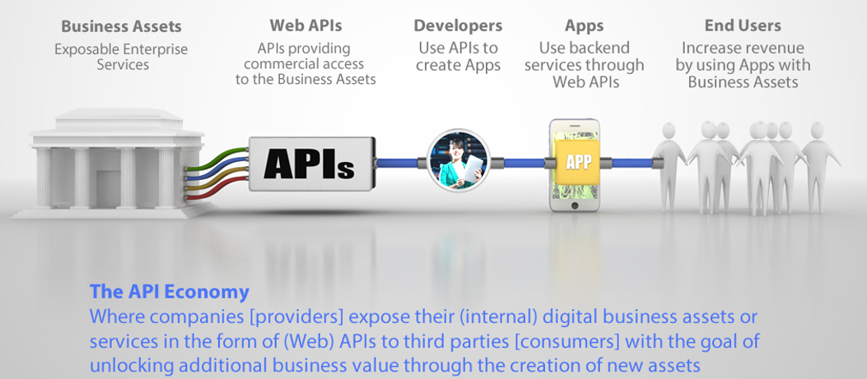
API Economy Value Chain
Notes:
Leading and innovative organizations are making their business information available (services, data) through business APIs to various types of developers – partner, public, private. These APIs are then consumed by developers to build their own apps for end users to use. This supply demand relationship creates this Economy of API Providers and API Consumers.

Slide 18
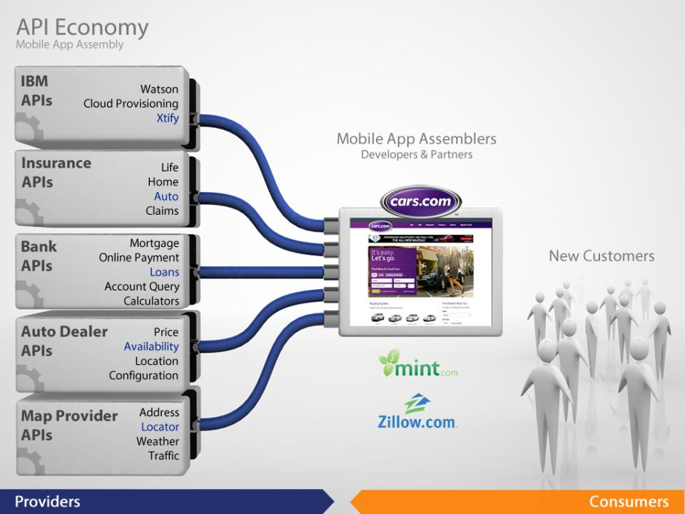
Notes:
Let’s look at the Cars.com mobile app as an example.
Cars.com is a consumer of APIs, and has assembled several 3rd party apis together to form the base function of their cars app.
For example, they use a Map Provider API to provide a “store locator function”
APIs from a car dealer data aggregator for availability of certain makes and models.
They use APIs from a Bank to offer Loan calculators and origination
Auto insurance from an Insurance companies APIs
And can imagine them using the new Xtify API from IBM to provide notifications, that a car they were looking for was now found.
18

Slide 19
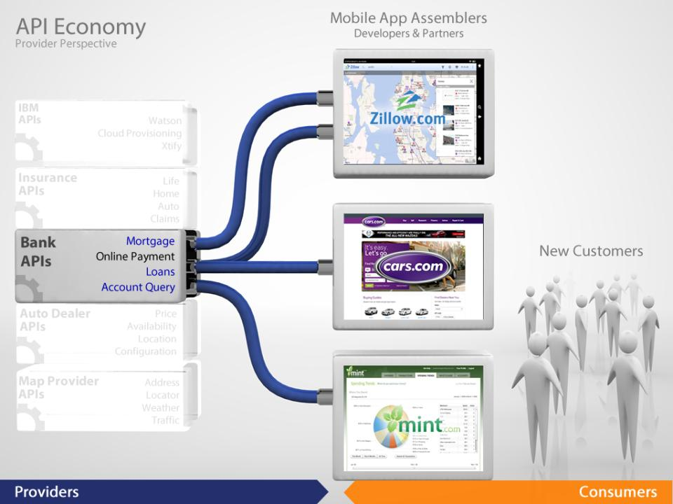
Notes:
Now, let’s look at the API Economy from the Providers perspective
The Bank can extend it’s reach beyond customers doing on-line banking.
By offering an API, that includes Mortgage Calculators, Lon Origination, On-line Payment, and Account Query
the bank can reach new mobile app providers link Cars.com (automotive sales), Zillow (on line real-estate), and Mint (financial data aggregator)
Which…
19

Slide 20
Common API use cases
Provide omni-channel access to business information for accelerating internal app development
Collaborate with business partners faster, in an open but secure & managed way, while providing a complete self-service experience
Power Mobile apps with enterprise business logic to innovate and provide high value to customers – digital transformation focus
Power IoT apps with enterprise information to drive innovation – digital transformation focus
Centrally manage the consumption of business logic, across the enterprise, for both Systems of Record & Systems of Engagement
Publish APIs publicly to drive innovation, tap into broad developer ecosystem and promote brand
Extend brand reach from Systems of Record to bridge to Systems of Engagement
Provide secure composite services in the Cloud
Provide managed access to 3rd party Cloud services to app dev teams to achieve centralized governance and cost optimization
Enable new business channels by monetizing enterprise data

Slide 21



Apps, Wearable's, IoT – newest System of Engagement for business
Apps, Wearable's, IoT are emerging as the newest System of Engagement for business to connect personally with their customers
Banks, Retail, Travel and Transportation (Airlines, Hotels, …) are the latest industries taking advantage of this touch point
API Powered Services
Systems of Engagement
Systems of Record
CRM
HR
DB
ERP
Continuous client experience
Cloud-based Services
Partner value chain
Internet of Things

Slide 22
Conceptual Architecture of a 12 week Engagement which produced 4 Wearable Watch Applications. Built on Services, Micro Services enabled with APIs
System of Engagement (SoE)
API Layer
Services Layer
System of Record (SoR)
Legacy Layer

Slide 23



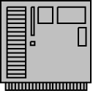
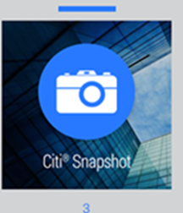
Typical Interactions between Android Phone, Watch, APIs and Services
Architecture Overview of a 12 week Engagement which produced 4 Wearable Watch Applications. Built on Services, Micro Services enabled with APIs
Scenario: Display Credit Card Account Snapshot on Android Smart Watch
Internet
DMZ
GRN
Wifi
REST / JSON
SOAP/XML
IBS
API Gateway
ESB
Account
BLT
CCS
LISA Service
Virtualization
Authentication
Product Content

Slide 24
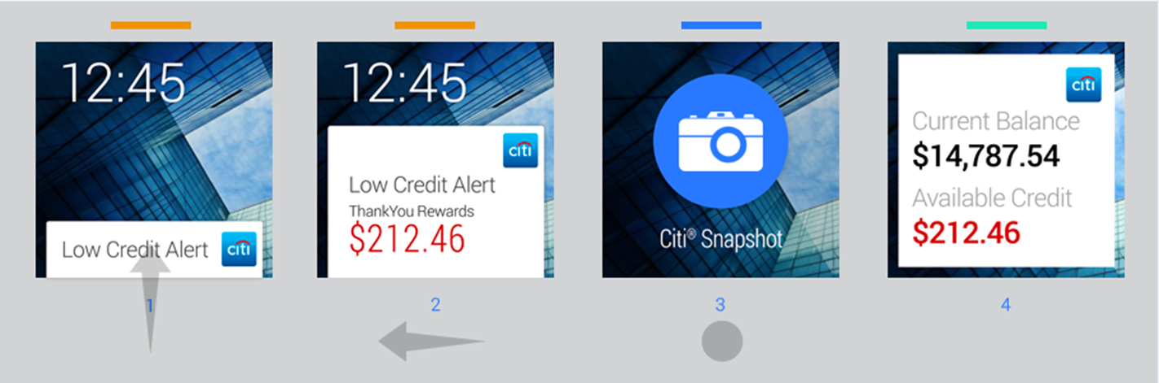


UI – API – ESB/Services Interactions
CCS
API Gateway
IBS
Citi Alert
ESB Web Service

Slide 25
Our Approach with large Enterprises
A Solution/Value Add Approach
Recognizes the different needs of an Enterprise and it’s challenges to implement Cloud, APIs, Services (micro, web, SOA) holistically.
PoC’s and one off stand alone project work well when the customer is kicking the tires and when they don’t have to scale the solution.
Lead with the Solution/Value Add that uses PaaS and API Gateway and other tools.
Leverages PaaS to help them:
Accelerated their migration to a PaaS development approach and Addresses all the benefits this approach makes possible like
Meeting Multi-speed IT needs
Standardization of code, components, development assets and other tooling,
Automated delivery pipeline
A path to leverage their existing investment in Services as Systems of Record.

Slide 26
Our Approach with large Enterprises – Deliverables and Guidence
The deliverables of this approach are:
An API Build Book -- API and API Management best practices, architectures. metrics, standards, patterns and anti patterns. We address the relationship between Services, Micro Services and API's and why you wire or configure APIs to services and micro services
Integration Patterns for the Cloud, application migration, and the use of APIs with a services and micro services layer.
A Target Operating Model -- API, Services, Micro Services Governance Model, Life Cycle Governance mapped to the APIm tool, a CoE model for API Economy adoption, Ownership model for services, micro services and APIs as products.
A Dev/Ops Build Book -- Dev/Ops best practices, architectures. metrics, standards, patterns and anti patterns, Tooling types and list, and automation scripts to build a delivery pipeline for App, application (web, browser, traditional)
Security and Utility Layer as a Service Model and suggested best practices -- Tokenization, OAuth, Logging, data access approaches and patterns.

Slide 27
Our Approach with large Enterprises – Deliverables and Guidence
Additional Deliverables of this approach are:
Cloud Migration Strategy and Maturity Assessment -- We look for patterns in a client's current Enterprise, to see how well it matches their proposed Cloud Reference Architecture. We can show where they might have easier, or harder paths on the way to achieving their Cloud strategy.
"Cloud Adoption" vs. "Cloud Optimization"...It's really not enough for a client to take their existing Enterprise to cloud if they don't change their practices along the way. After Cloud Adoption, another iteration has to take place - Cloud Optimization
Clients need to look at their existing processes to see where they can be improved for and with cloud
Clients need to look for opportunities to leverage elasticity
Clients need to look for opportunities to quiesce workloads during quiet periods... like maintenance or test systems
Clients need to look for workloads that can be re-factored with cloud hosting in mind - Use of APIs, use of PaaS, use of scale
We describe how to implement all of the above in Bluemix Dedicated and stand alone.

Slide 28
Innovation Lab and Development Factory – Accelerate Development – Transform the Enterprise at Speed, On Mass
The Innovation Lab and Development Factory addresses
The need for an organization to quickly develop and deliver Minimal Viable Product
Accelerated this development thru the use of a dedicated single tenet sandbox integrated with the customer's enterprise.
Access their data in their internal enterprise data repositories
Quickly provision what they need in a sandbox for continuous development and delivery to an internal DevOps delivery pipeline.
Iterate this approach to Transform the Enterprise
Scale development in a Factory model
Put in Place the needed Organization and Controls (Governance or TOM) to make the transformation real.

Slide 29
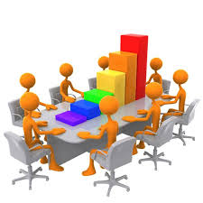
Incubation Lab & Development Factory
A Pre development environment to create, improve, transform and maintain new and existing products then advance the product to leverage iterative build factory.
Process - Built on Agile and Lean methods enabling fast Discovery, Successes, Failures, Learning and Recoveries
People - Product Dedicated Teams that work in well defined sprints enabled by the shared services of the Lab
Technology - An Development Factor Isolated from the encumbrances of the customers legacy enterprise & road blocks
Primary Use Cases
Project Characteristics
New API product idea test market validation
New System of Engagement product idea test market validation
Proof of concept validation
Minimum viable product creation
Hackathons to identify new product ideas
Rapid application change in response to market imperatives
Rapid environment readiness required
Assisted Agile development
Development teams interested in leveraging a large public, private, and proprietary services pallet
Rapid continuous development and delivery
Standardized development environment with reusable assets
Isolated environment to minimize enterprise risk

Slide 30


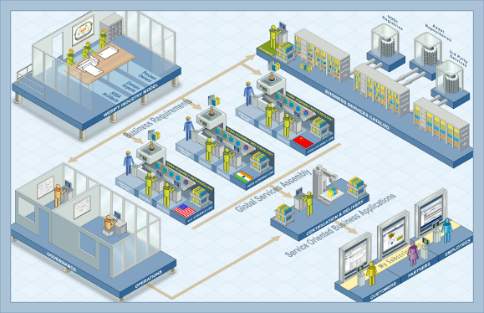
The Incubation Lab & Development Factory Concept
An incubator for Product Innovation and Transformation
A “Factory” for Services, Application & API development at Speed
Focused on people, process and technology
A permanent part of the Corporate landscape and transformation
Use of Lean Startup and Disciplined Agile concepts
Three Patterns – Systems of Engagement, Interaction and Record
Increased velocity, frequency, standardization achieved with a development factory model
Development, Test Sandbox– Bluemix, Local or Dedicated with Public/Private Srv Pallet
Architecture/Design Center
EA
Bluemix, Local or Dedicated DevOps Control Point
Lean Startup/ Agile Method & Scrum Teams
Architecture/Design Center
Scrum Teams
PaaS/Virtual Environments
Agile Teams
Product Owners
PMO/Project Intake & Prioritization
Development
PMO
Operations Engs
DevOps
PMO

Slide 31


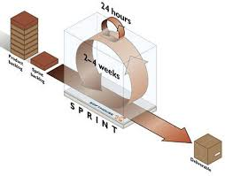
The Incubation Lab & Development Factory Project Pilot Scope
IBM will implementing upto 4 services in a 6 week pilot MVP mobile app effort built using the Bluemix on IBM owned platform dedicated to Customer:
Consult and Mentor in the strategy for creating APIs, using Agile, Lean & Extreme Programming techniques.
Identify Business Proposition & Goal for the Pilot Product
Identify a Product Owner to drive value and Vision
Consult with customer to define a product Profile and Targeted Market
Create a Bluemix Development Space, Assets and Services.
Create a Lean Start up Agile team with Co-Located IBM and Customer Resources
Decompose the larger pilot product vision into deliverables
Identify & Build APIs, Services and/or Micro Services needed to Enable Multi-Channel Consumption
Identify Acquire from Customer Simulated Data to support service components
Prioritize projects, Create Scrum Sprints and a Sprint Backlog to fit the pilot time box
Develop, Release, Monitor, Analyze Feedback & Repeat to Improve
With a Bluemix subscription IBM will provide a Bluemix Architect for 6 months Free

